Slide 1
Calico Gateway API
Month Year
Presented by Solutions Architect

Slide 2
Legacy Ingress API vs Gateway API
Ingress2gateway & Challenges
Example of migration

Slide 3
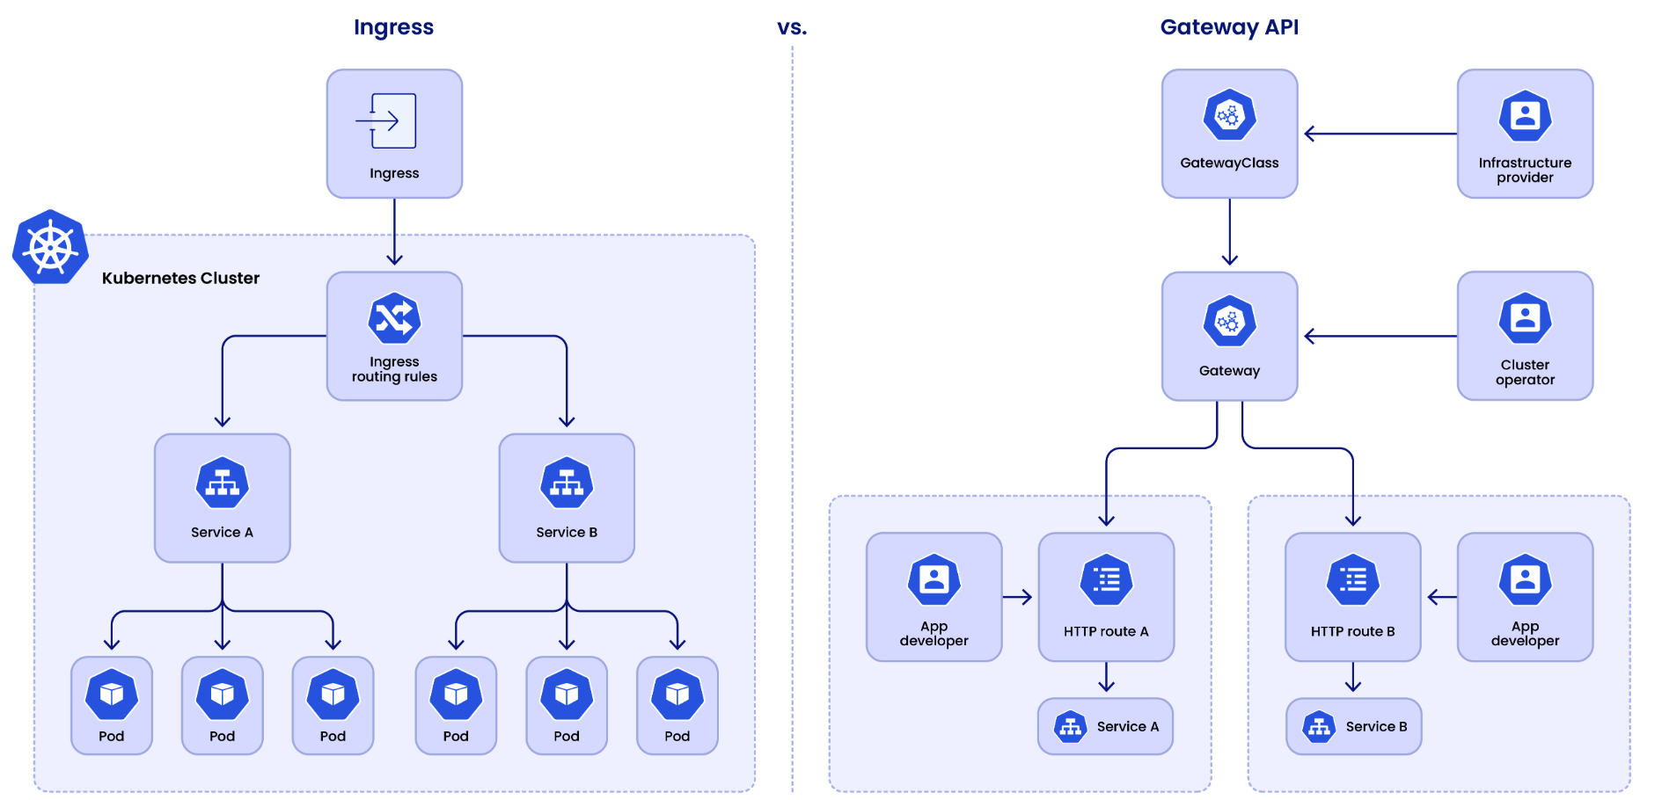
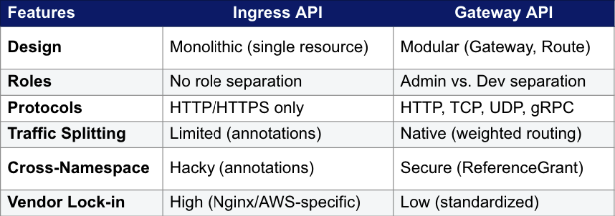
Legacy Ingress API vs Gateway API
Notes:
Why Gateway API?
Future-proof: CNCF-standard, replacing Ingress long-term.
Multi-role: Platform teams manage infra; devs manage routes.
Advanced L4/L7: Supports TCP/UDP, gRPC, and mesh integration.

Slide 4
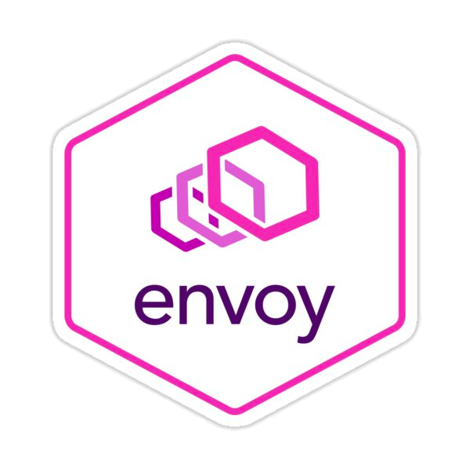

Ingress2gateway & Challenges
ingress2gateway tool
It simplifies the migration by transforming Ingress resources into Gateway API resources that Envoy Gateway can use
Ingress VS GatewayAPI
Ingress features and options are usually configured via annotations (vendor lock-in)
GatewayAPI features and options are managed by CRDs
Challenges
Not all annotations can be translated by the tool
Some options, for example OIDC integration, require a manual translation

Slide 5
Ingress2gateway & Challenges
Ingress2gateway supports translating these ingress-nginx specific annotations
nginx.ingress.kubernetes.io/canary: If set to true will enable weighting backends.
nginx.ingress.kubernetes.io/canary-by-header: If specified, the value of this annotation is the header name that will be added as a HTTPHeaderMatch for the routes generated from this Ingress. If not specified, no HTTPHeaderMatch will be generated.
nginx.ingress.kubernetes.io/canary-by-header-value: If specified, the value of this annotation is the header value to perform an HeaderMatchExact match on in the generated HTTPHeaderMatch.
nginx.ingress.kubernetes.io/canary-by-header-pattern: If specified, this is the pattern to match against for the HTTPHeaderMatch, which will be of type HeaderMatchRegularExpression.
nginx.ingress.kubernetes.io/canary-weight: If specified and non-zero, this value will be applied as the weight of the backends for the routes generated from this Ingress resource.
nginx.ingress.kubernetes.io/canary-weight-total
https://github.com/kubernetes-sigs/ingress2gateway/blob/main/pkg/i2gw/providers/ingressnginx/README.md

Slide 6
Sample of NGINX Ingress
Canary deployment (will be translated in GatewayAPI HTTPRoute)
OIDC Authentication (will be manually converted in GatewayAPI SecurityPolicy)
apiVersion: networking.k8s.io/v1
kind: Ingress
metadata:
name: my-app
namespace: default
annotations:
kubernetes.io/ingress.class: nginx
nginx.ingress.kubernetes.io/auth-url: "http://oauth2-proxy.default.svc.cluster.local:4180/oauth2/auth"
nginx.ingress.kubernetes.io/auth-signin: "https://$host/oauth2/start?rd=$request_uri"
nginx.ingress.kubernetes.io/canary: "true"
nginx.ingress.kubernetes.io/canary-weight: "20"

Slide 7
Sample of GatewayAPI resources
Gateway
HTTPRoute
SecurityPolicy
apiVersion: gateway.networking.k8s.io/v1
kind: Gateway
metadata:
name: nginx-to-cig
namespace: default
spec:
gatewayClassName: tigera-gateway-class
listeners:
- hostname: echoserver.myingress.com
name: echoserver-myingress-com-http
port: 80
protocol: HTTP
apiVersion: gateway.networking.k8s.io/v1
kind: HTTPRoute
…
rules:
- backendRefs:
- name: app-v1
port: 8080
weight: 80
- name: app-v2
port: 8080
weight: 20
matches:
- path:
type: PathPrefix
value: /
apiVersion: gateway.envoyproxy.io/v1alpha1
kind: SecurityPolicy
…
spec:
oidc:
provider:
issuer: "https://accounts.go……”
clientSecretRef:
name: oidc-client-secret
key: client-secret
authorizationEndpoint: "https:.."
tokenEndpoint: "https://oaut…."
userInfoEndpoint: "https://op…"
redirectURI: "https://myapp.e…"

Slide 8
Summary of Sample Migration
NGINX Ingress
Calico Ingress Gateway
Vendor specific
Number of resources: 2
ingress for app-v1
ingress for app-v2 (canary)
Kind: Ingress
“Canary” annotations
“OIDC” annotations
Standard k8s GatewayAPI
Number of resources: 3
Gateway
HTTPRoute
SecurityPolicy
Kind: Gateway
Kind: HTTPRoute
Kind: SecurityPolicy

Slide 9
Thank you

